Slide 1
Project title
What happens if it all goes wrong?
Dr Anna Willetts and Samantha Riggs
Date Month 2014
20 June 2017

Slide 2
Environmental Sentencing Guidelines
1. What are they?
2. What is their aim?
3. What is the result?

Slide 3
Environmental Sentencing Guidelines – Why?
Appeals dismissed by R v Network
Rail Infrastructure Ltd. and R v Sellafield Ltd.
Judges’ comments:
‘…bringing home to the directors of
Sellafield Ltd and its shareholders the
seriousness of the offences
committed and provide a real incentive to them to remedy the failures
‘The court will consider seriousness of the offence and then the financial circumstances of the offender. The fine must be fixed….with the objective of ensuring that the message is brought home to the directors and members of the company (usually the shareholders)’.

Slide 4
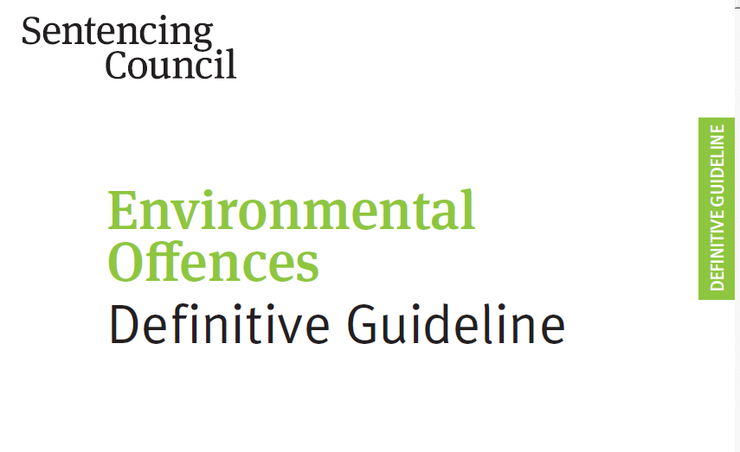
Environmental Sentencing Guidelines
12 step set of guidelines:

Slide 5
Environmental Sentencing Guidelines – What?
The Court must consider:
Offence ‘Category’ and ‘Culpability’
Four categories
Four levels of culpability

Slide 6
Culpability
Deliberate
Intentional breach of or flagrant disregard for the law
Reckless
Actual foresight of, or wilful blindness to, risk of offending but risk still taken
Negligent
Failure by the organisation to take reasonable care to put in place and enforce systems for avoiding offence
Low or no culpability
Little or no fault on the part of the organisation, e.g. a rogue employee

Slide 7
Categories
Category 1
Polluting material of a dangerous nature
Major adverse effect on air, water, amenity; major costs for clean up.
Category 2
Significant adverse on air, water, amenity,
Significant adverse effect on human or animal health
Category 3
Minor localised adverse effect on water, air etc and limited interference with other lawful activities.
Category 4
Risk of Category 3 harm.

Slide 8
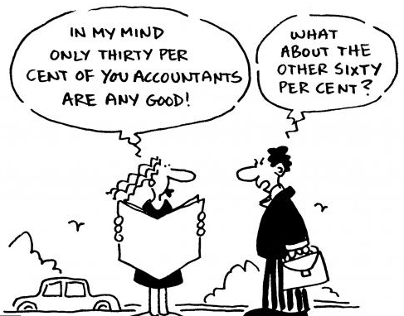
Environmental Sentencing Guidelines
Starting point and category range
Level of fine should reflect the extent to which the offender fell below the required standard.
Companies or partnerships must provide accounts
for the last three years.

Slide 9
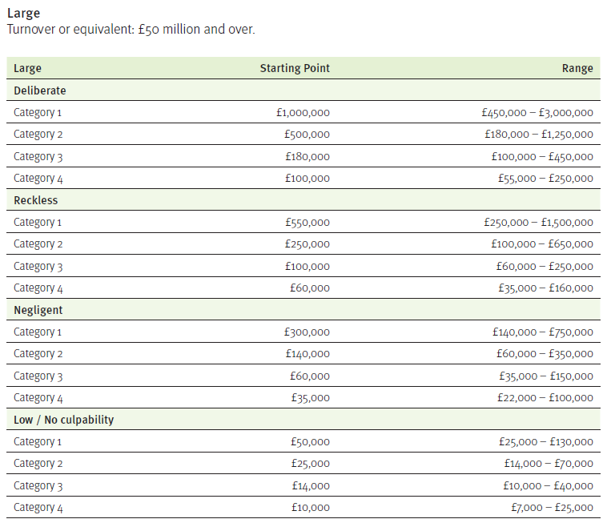

Slide 10
Aggravating and Mitigating factors
Aggravating factors Mitigating factors
Previous convictions No previous convictions
History of non-compliance Steps taken to remedy problem
with warnings by regulators
Location of offence, e.g. near Remorse
housing, schools
Repeated incidents over Compensation paid voluntarily
extended period of time
Deliberate concealment Effective compliance programme
Ignoring risks Self-reporting
Committed for financial gain Little or no financial gain

Slide 11
Environmental Sentencing Guidelines
Remaining Steps
Ensure that financial orders remove any economic benefit derived from the offending.
Is proposed fine based on turnover proportionate to means of the offender?
Assistance to the prosecution
Reduction for guilty pleas
Ancillary orders such as forfeiture of vehicles or plant

Slide 12
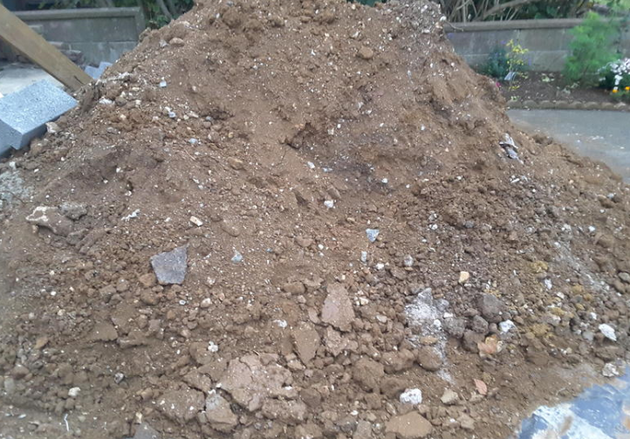
Case Study
Client operated a small construction business, Sole Trader. £10milion turnover
Removing soil and fill from sites for property development
Usually takes to recovery sites or landfill
Winter 2014, poor weather, many sites closed
Brought materials back to his yard for temporary storage

Slide 13
Case Study
EA visits and views soils in yard, says no environmental permit in place for storage of ‘waste’
Client arrested at dawn at home, interview under caution
Charged with Regulation 12 offence ‘operating a regulated facility without a Permit’

Slide 14
Case Study
Individual charged
Accepts the offence has taken place but does not accept individual personal liability because:
All paperwork (including WTNs) in name of company
All timesheets for drivers in name of company
All invoices in names of company
All instructions given by Site Managers not Director
No evidence Director acting on his own
Indicate to EA that company will plead guilty but not Director.
EA grudgingly accepts!

Slide 15
Case Study
Prosecution case:
Category 2 harm
Continued period of offending
Defence mitigation:
Category 3 harm
Early guilty plea
Accepted responsibility at interview
No previous convictions
Steps taken to remedy
No financial gain
One off event due to weather, not financially motivated

Slide 16
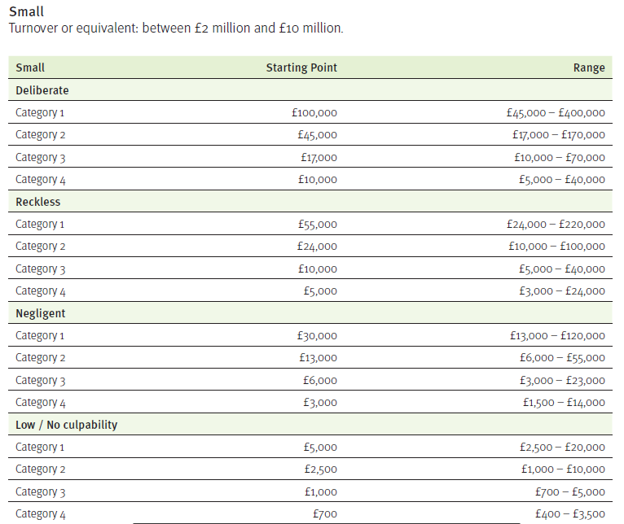

Slide 17
Outcome
Negligent
Category 3
£9000 fine and costs

Slide 18
Case Study
You might wonder….
Why persistence in individual – Company shift.
Apart from the lack of evidence:

Slide 19
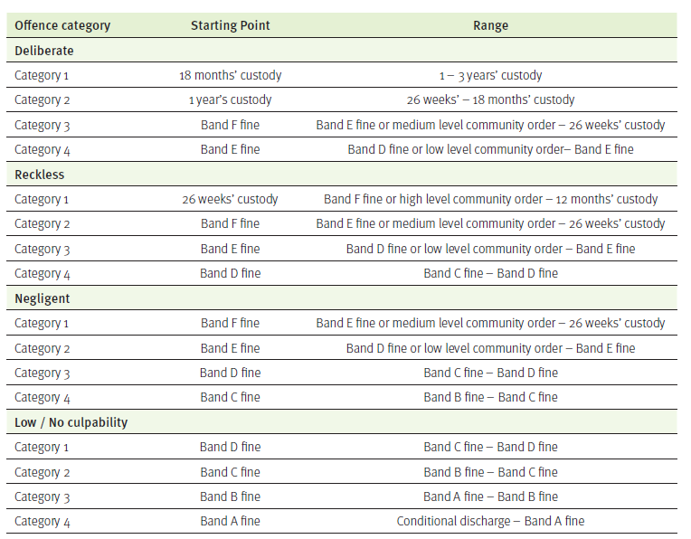

Slide 20
Summary
Fines now much higher than previously
Regulators not just targeting traditional ‘waste’ companies
Applies to construction and demolition businesses which produce waste and have a duty to manage waste
Liability of individuals – Directors, Managers and Sole Traders
Potential for custodial sentences
If in doubt – take advice!

Slide 21
Thank you
Anna and Sam

