Slide 1
Putting the Right Waste, in the Right Place
A Focus on the Construction Sector
CIWM North East, FSB & Partners
16 February 2017
Alan Holmes, RWRP Campaign

Slide 2
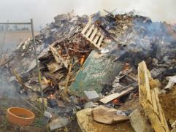
The Session today:
• The importance of ‘Duty of Care’ to all parties in the ‘Waste Chain’
Tackling Waste Crime and non compliance
Opportunities in ‘doing the right thing’ with waste
The ‘right Waste right Place’ campaign, raising awareness of Duty of Care – importance of construction sector

Slide 3
Aims of the Campaign: To raise awareness across waste producing business sectors of the importance of Duty of Care and compliance.
Timescale: April 2016 to March 2017 …and now beyond!
Why?
Duty of Care awareness is key to reducing waste crime - Waste criminals need waste!
Drive company compliance and a secure audit trail
Provide a level playing field
Business benefits & standards

Slide 4
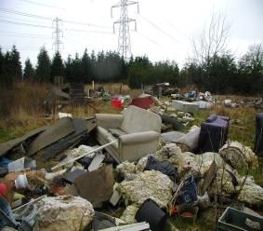
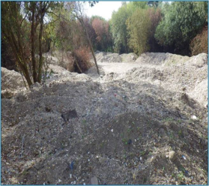
Flytipping: nearly 1 million incidents/yr (Householders too!)
£150 million cost to Local Authorities and rising
Total cost of waste crime
= £1 billion per annum?
Nearly 1000 new illegal sites added to EA database every year
Abandoned sites and fires, undermined legitimate business
Key sectors

Slide 5
Tackling Waste Crime
Waste crime is a priority for government and legitimate industry
Resources being provided to the Environment Agency to crack down on waste criminals
Government Waste Crime Action Plan: new enforcement measures, penalties – more on the way
Revised Statutory Duty of Care Code of Practice
Industry Committed - ‘right Waste, right Place’ campaign, endorsed by Govt and EA

Slide 6
Obligations on ALL holders
Section 34 (1) of EPA90
prevent any contravention by any other person of s33 [Permits or Exemptions]
to prevent any contravention by any other person of regulation 12 of the Environmental Permitting Regulations 2010 or of a condition of a permit granted under those Regulations [Performance]
prevent the escape of waste from his control or that of any other person

Slide 7
transfer only to an ‘Authorised person’
https://www.gov.uk/guidance/
access-the-public-register-for-environmental-information
b) to ensure [adequate] written description of the waste on transfer (Edoc, CWTN or Waste Information)
Not just these 2 obligations!

Slide 8
Campaign Products
Dedicated website: Downloadable content, interactive, videos/animation, guidance, links to third parties www.rightwasterightplace.com
Best Practice Guidance: ‘Simple guides’, case studies, waste ‘need to know’ cards, FAQs, leaflets, infographics and posters : easy to read, downloadable.
Events: workshops, experience exchanges, best practice
Market research: Gauge awareness of Duty of Care.
Press Office: drive interest in the campaign.
Active Engagement: Ambassador Programme.

Slide 10
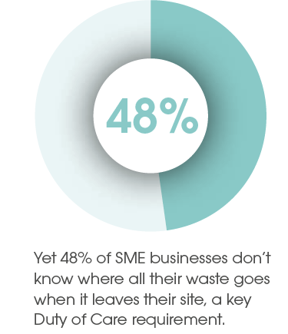
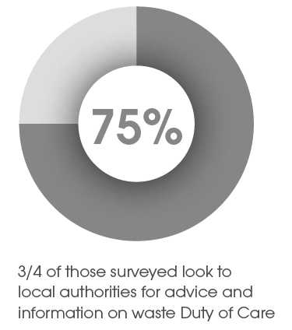
RWRP Campaign Survey

Slide 11
RWRP Campaign Survey
More than a third were unsure whether they completed Waste Transfer Notes (WTN)
Only half of construction businesses stored WTNs for the required two years
A quarter of construction businesses did not always separate/segregate their waste
* EA experience >90 transfer notes not completed correctly

Slide 12
Active Engagement
Campaign managed by the ESA and CIWM and supported by the Environment Agency, Defra, WAG, Natural Resources Wales
Strong ‘buy in’ from a number of waste producing and waste managing businesses, sectors and local councils
Ambassador Programme - to promote the campaign through supply chains
Activities around the country involving other organisations

Slide 13
Ambassador Programme
Formalises engagement between the campaign and associated third parties and expectations.
Ambassadors commit to:
Providing evidence that the organisation embraces the principles of ‘right Waste, right Place’, and has an internal programme and policy on waste management.
Promoting best practice with regard to waste management.
Actively engage with RWRP to promote the campaign.

Slide 14
Ambassador Programme
…and expanding…
Notes:
Plus
Biffa
Keep Britain Tidy

Slide 15
Next Steps
Sector focus: Guidance, Case studies, seminars and training events
Expand the Ambassador Programme
Contact info@rightwasterightplace.com
Engagement with devolved governments to further expand the campaign i.e. Wales
Continue until at least March 2018….

Slide 16
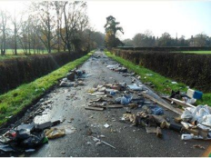
In Summary
Tacking waste crime is a priority
Awareness of Duty of Care across the whole waste chain is key to encourage behaviour change
Collaboration is key – Ambassador Programme and Supply Chain
Focus on the construction sector as a key sector
‘Right Waste, Right Place’ providing support and guidance for duty of care, code of practice

Slide 17
Thank you !
Website: www.rightwasterightplace.com
Email: info@rightwasterightplace.com
Follow: @RWRP2016
Like: info@rightwasterightplace.com
Alan Holmes
07768 907610

