Slide 1
A Managing Contractor’s Perspective
Alison Brough
Senior Environmental Manager
Willmott Dixon

Slide 2
About us
3,000
10,000
£1.3 billion
Notes:
So, a family owned business operating in the UK, our overseas division is the isle of white
We have around 3100 direct employees, and at any one time have around 10,000 supply chain partners working on our projects,
Established over 160 years with a turnover of £1bn

Slide 3
Sustainable Development
Notes:
So, a family owned business operating in the UK, our overseas division is the isle of white
We have around 3100 direct employees, and at any one time have around 10,000 supply chain partners working on our projects,
Established over 160 years with a turnover of £1bn

Slide 4
Waste Performance

Slide 5
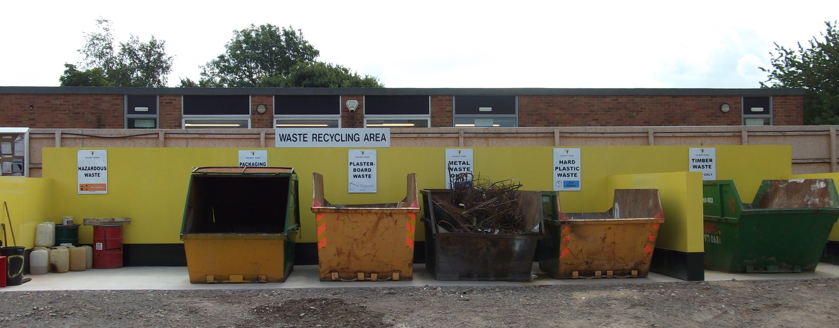
Managing Contractor
150 sites
Free issue
Supply chain packages
S/C trade exemption
Notes:
We operate on average 150 sites nationally within local companies. Each company has established waste contractor relationships with triennial audit for DoC assurance, offering internal assurance for all companies to use approved waste contractors. Waste service will be included within packages of work (free issue) or specified that the S/C will only use appointed waste contractor for that area, or be recharged proportionally for amount of waste produced on site (recharge by waste stream and per wheelie bin), to incentivise waste reduction.

Slide 6
Challenge and Opportunity
97% think complying….
….but lack DoC evidence (legal & commercial docs)
>33% not sure kept WTNs
WTN for data
What are you paying for?
Notes:
Stats came from rwrp campaign

Slide 7
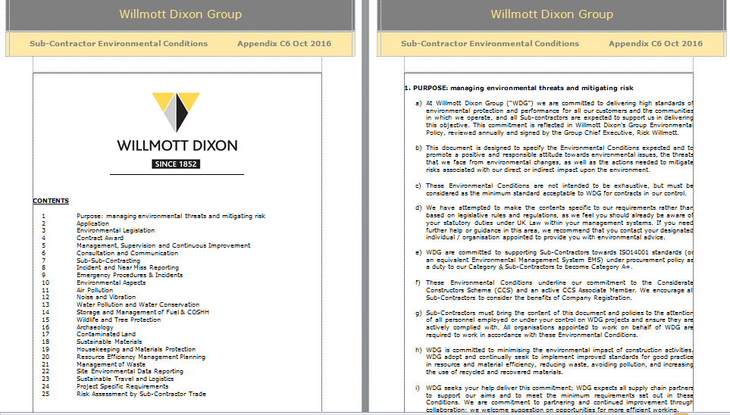

Slide 8
What is Waste?
“any substance or object that the holder discards, intends to discard, or is required to discard.”
Not Waste if…
The material is to be used as part of the development WITHOUT further treatment.
Notes:
The European Waste Framework Directive defines waste as ….
Waste implies unwanted or unusable materials. The term is often subjective because waste to one person is not necessarily waste to another.
The UK Contractors Group (UKCG) have produced a ‘what is waste guide’ which answers some FAQ around waste for e.g. (read question at bottom of slide)
Answer - This is Demolition Waste as this is deemed to have been discarded, even if the crushed material is subsequently bought back as aggregate to the producing site.

Slide 9
Waste Types & Landfill Tax
Inert
Sub soils
Stone
Sand
Concrete
Glass
Ceramic
Brick
Non-Hazardous
Top soil
Paper, cardboard
Wood, metal
Mixed waste
Pipe & ducting
Cable
Tarmac
Plasterboard
WEEE
Invasive Species
Packaging
Persistent Organics
Hazardous
Contaminated spoil
Oils and chemicals
Used spill kits
Aerosols
Batteries
Lighting tubes
Asbestos
Paint tins
Difficult Wastes
Are not hazardous but require particular care & handling techniques
Notes:
Inert waste is waste that is not biologically or chemically reactive and will not decompose. Cheaper landfill tax £2.60 per tonne
Non-Hazardous is waste that is often commercial/industrial/domestic that does decompose but not have hazardous properties. Landfill tax has significantly risen each year and is now currently £82.60
Hazardous waste is waste that is dangerous or potentially harmful to our health or the environment. Hazardous wastes can be liquids, solids, gases, or sludges. No mixing hazardous waste with non-hazardous as all will have to be treated as hazardous. The cost for hazardous waste disposal can be many hundreds of pounds/tonne higher. This isn't just due to the charge for the waste disposal itself but also due to landfill tax of £80/tonne and the relatively small number of hazardous landfills left in the UK (hence transportation costs can become very significant).

Slide 10
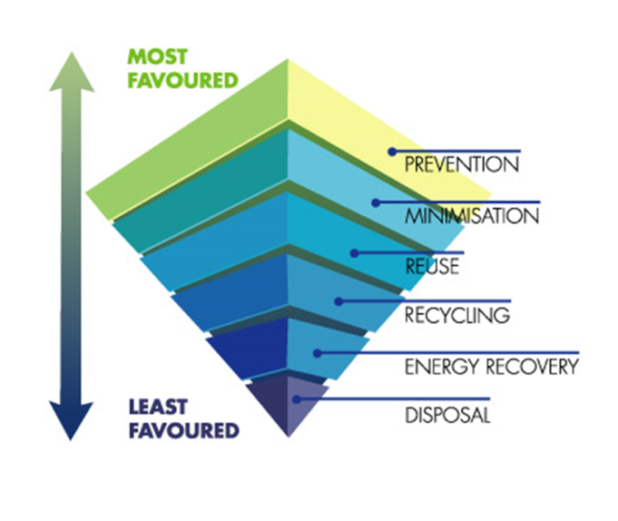
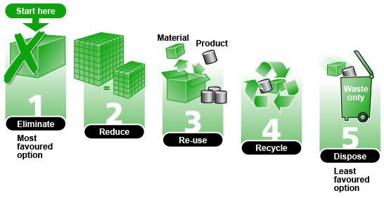
Waste Hierarchy
Every day UK plc throws away profit with the waste it produces.
Despite reduced waste and better recycling, the construction industry generates more than a 3rd of the UK’s waste.
The true cost of a skip being estimated at around £1300
Applying the waste hierarchy helps action at all project phases (design>delivery) and increases resource efficiency and reduces legal liability
Notes:
Eliminate and Reduce – measures taken before a material or product has to become a waste e.g. Only buy quantities you need, designing so the building +/or materials last longer.
Re-use – Materials to be re-used within its natural state without any treatment +/or processing.
Recycle – Recovery operation by which waste materials are reprocessed into products or materials e.g. crushing demolition materials to produce aggregate.
Before disposal you can also recover which means essentially burning waste to produce energy such as fuels, heat and power.
Disposal – This is the last resort and requires waste being sent to landfill which is costly and has an impact on the environment.
10

Slide 11
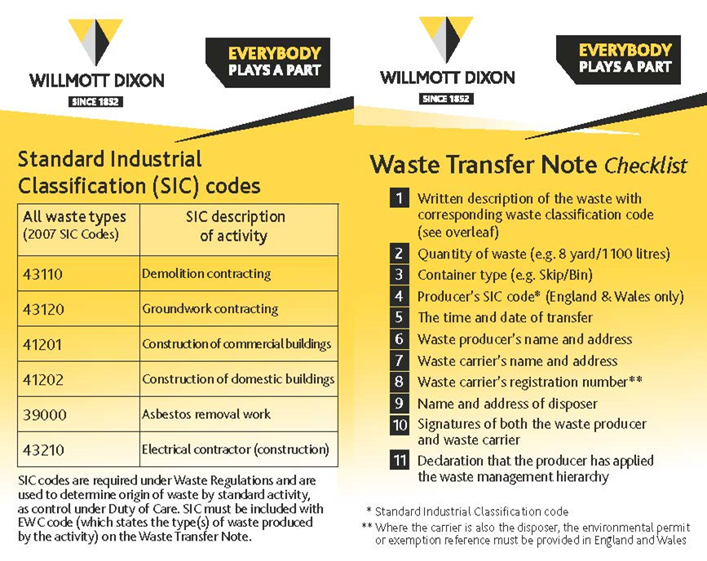
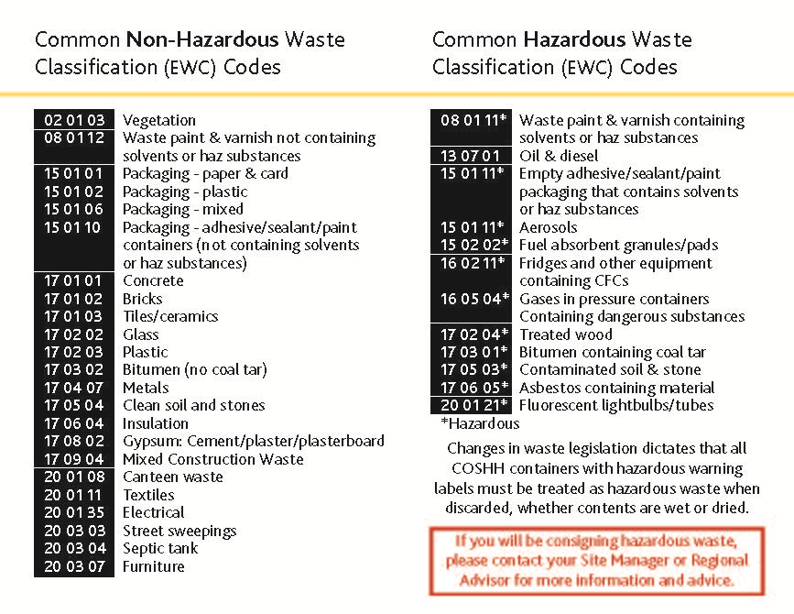
Ensure you have correct waste documentation – use of Waste Card
Waste Classification (EWC & SIC)
Duty of Care checks – carriers licence & permitted destination site
Hazardous Waste Consignment

Slide 12
Duty of Care (DoC)
Deal with waste correctly from cradle to grave. The Duty is to ensure waste is:
Properly segregated, stored, contained
Transported by a registered waste carrier (licence valid for 3 years)
Disposed of at a licenced/permitted disposal site (transfer station or tip)
These need to be checked on the Environment Agency website
Waste Transfer Notes completed and retained for 2yrs
Hazardous Waste Consignment Notes completed and retained for 3yrs

Slide 13
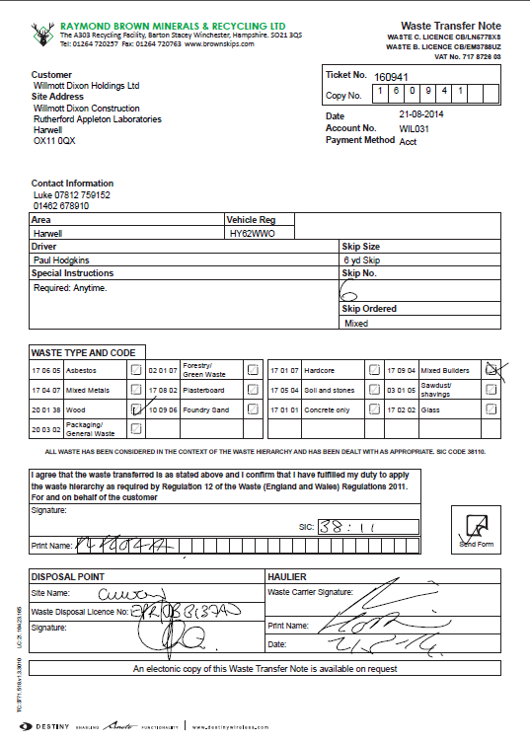
Waste Transfer Notes
Notes:
EXERCISE Spot the missing details on the waste transfer/hazardous waste consignment notes and licences.

Slide 14
Hazardous Waste Consignment Notes
Notes:
EXERCISE Spot the missing details on the waste transfer/hazardous waste consignment notes and licences.

Slide 15
Waste
Do
Plan storage and signage
Order materials cut to size
Reuse offcuts and spare materials
National Community Wood Recycling scheme
Reduced packaging
Reuse site setup supplies
Don’t
Accept materials until storage is available
Store without cover
Dispose without obtaining relevant licences/permits

Slide 16
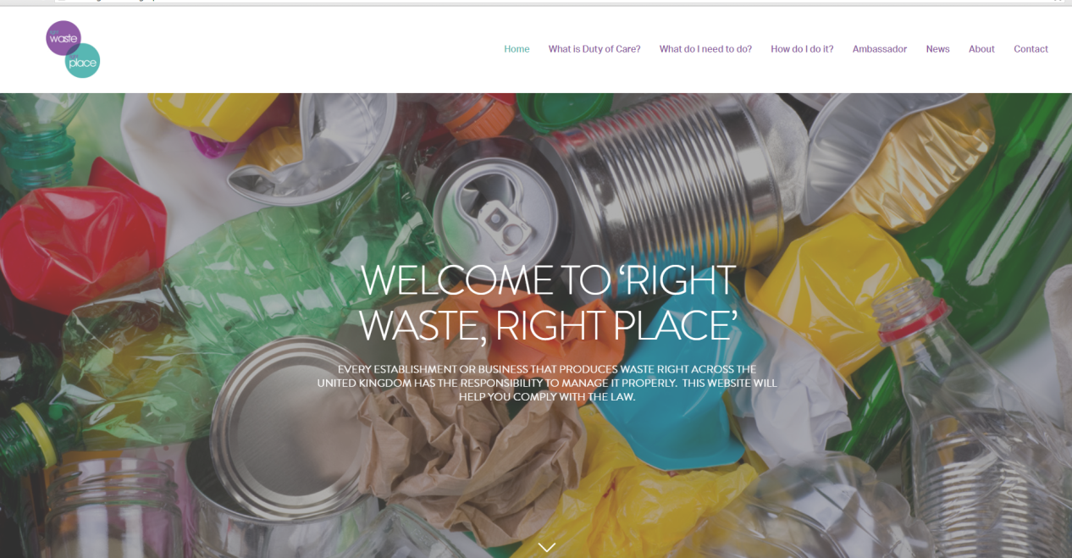
Most Important
Seek evidence of compliance
If in doubt

