Slide 1
Practical Compliance in the Construction Industry
Lara Ayris, Managing Director
20 June 2017

Slide 2
No two days are the same! No two projects are the same!
In the second quarter of 2015 the construction industry was worth £22.5 billion
There are more than 194,000 construction companies trading in the UK
More than 35% are either self employed, or run their own companies
1 in 14 of the UK work force is in construction which is approx. 2.1 million jobs (Q2 2015) and is approximately 6.2% of the total.
Construction jobs are not just builders, there are electricians, planners, designers, civil engineers, site managers, project managers and health & safety advisers to mention just a few.

Slide 3
So how do you ensure compliance?
Planning
Client Demands
Company Demands

Slide 4
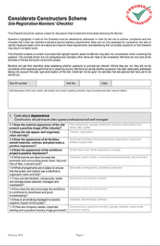
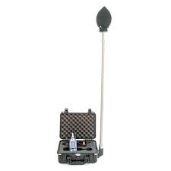
Examples of compliance requirements

Slide 5
KNOW, what needs to be complied with for each project
“To know and not to do, is not to know”
Ensure everyone on the project is aware of what needs to be complied with and why:
Site Guides
Sub Contractor agreements
Tender documentation
Induction and training
Tool box talks

Slide 6
How does Duty of Care fit in.
Legal requirement
Part of the SWMP requirements
Assists with Site Impacts for BREEAM
Assists with Considerate Constructors Scheme.

Slide 7
Duty of Care in the Construction Industry
Client
Principal Contractor
Demolition Contractor
Groundworks Contractor
Waste Brokers/ Companies
Other Subcontractors

Slide 8
Client
Principal Contractor
Demolition Contractor
Waste Contractors – Each requiring a valid Waste Carrier’s License
Waste Sites – Each requiring a valid Permit or Exemption

Slide 9
Client
Principal Contractor
Groundworks Contractor
Waste Contractors – Each requiring a valid Waste Carrier’s License
Waste Sites – Each requiring a valid Permit or Exemption

Slide 10
Client
Principal Contractor
Demolition Contractor
Groundworks Contractor
Waste Brokers/ Companies
Other Subcontractors
Duty of Care: A BIG issue in the Construction Industry

Slide 11
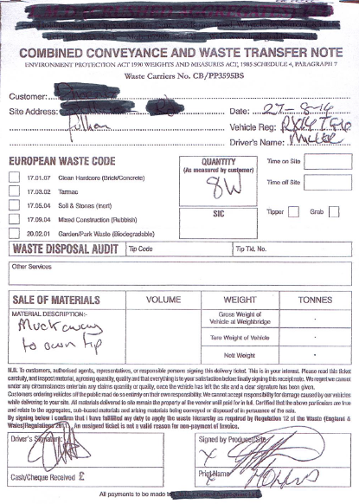
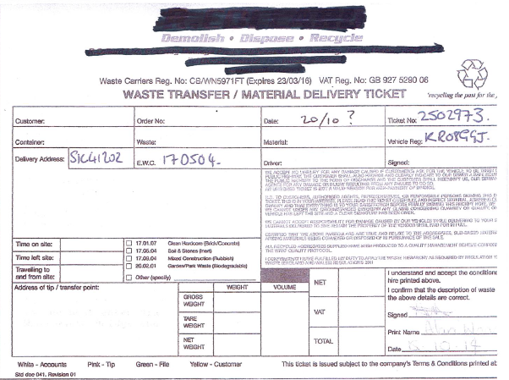

Slide 12
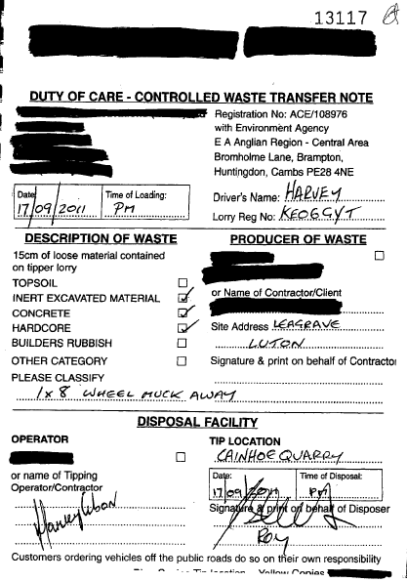
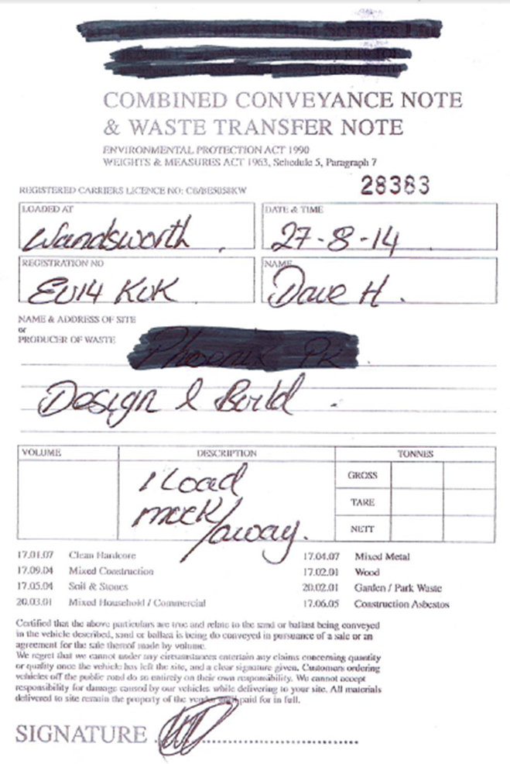
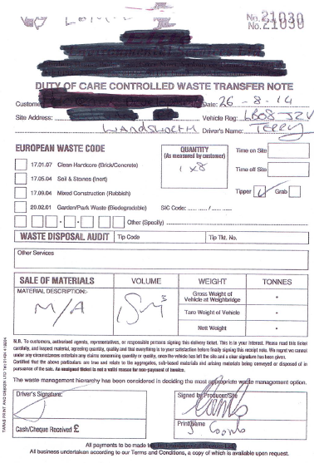

Slide 13
Be clear!
Ensure everyone is aware of what you are expecting from them?
What are you expecting from your sub contractors?
What are you expecting from your waste contractors?

Slide 14
Process is needed…..
What is and what isn’t acceptable to you?
What level of risk are you comfortable with?

Slide 15
Duty of Care – General Principles
Control throughout waste chain
Recognising and managing hazards and risk
Having procedures & reviewing them
Recognising & taking responsibility
Record keeping
Monitoring and reporting
Legislative compliance
Notes:
Not just hazardous and non-hazardous wastes … some non-hazardous wastes have significant potential hazards or potential for nuisance (dusts / odours etc)

Slide 16
Audit process must be put in place
Control of every stage of the waste chain
Learn how to recognise hazards and risk
Implement a management system for hazards and risks
Having procedures – review them regularly
Effective record keeping
Regular monitoring and reporting
Recognising when you are at fault and taking responsibility
Complying with legislation

