Slide 2
Putting the Right Waste, in the Right Place
A Focus on the Construction Sector
20 June 2017, Slater & Gordon, Birmingham
Dr Colin Church
CEO CIWM

Slide 3
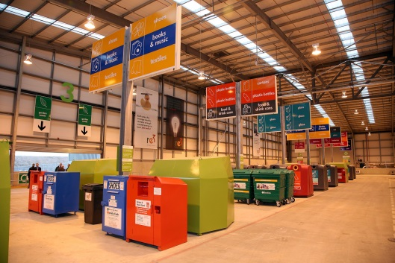
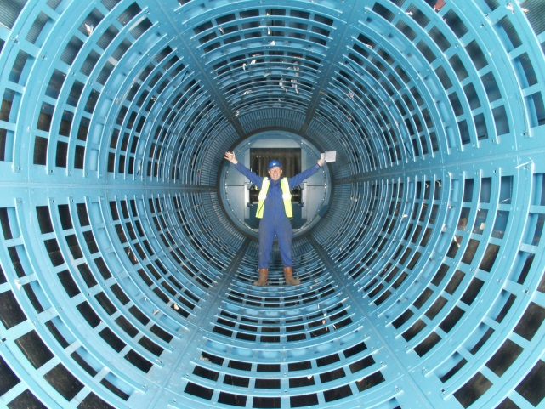
CIWM…
is the leading professional body for resource and waste professionals with about 5,500 members
uses our professional knowledge and trusted reputation to influence policy and help shape the future of the sector

Slide 4
The Session today:
• The importance of ‘Duty of Care’ to all parties in the ‘Waste Chain’
Tackling Waste Crime and non compliance
The ‘right Waste right Place’ campaign to raise awareness of Duty of Care – construction sector focus

Slide 5
Aims of the Campaign: To raise awareness across waste producing business sectors of the importance of Duty of Care compliance.
Timescale: April 2016 to March 2017 …and beyond
Why?
Duty of Care awareness is key to reducing waste crime – Waste criminals need waste!
Drives company compliance and a secure audit trail
Provide a level playing field
Business benefits
Notes:
Environmental, health and community impacts.
Waste taken to a waste site that is illegal
Waste passed on to another party that then passes waste to an illegal site
Waste passed on (e.g. via a broker) and exported illegally (e.g. electronic waste)
Waste mislabelled or mixed with other wastes e.g. to avoid paying higher’ landfill tax rate of £84.40 per tonne (vs low rate £2.65 per tonne for ‘inactive’ waste) or waste being included in single stream recyclables, such as paper for export abroad.
Waste criminals need waste!

Slide 6
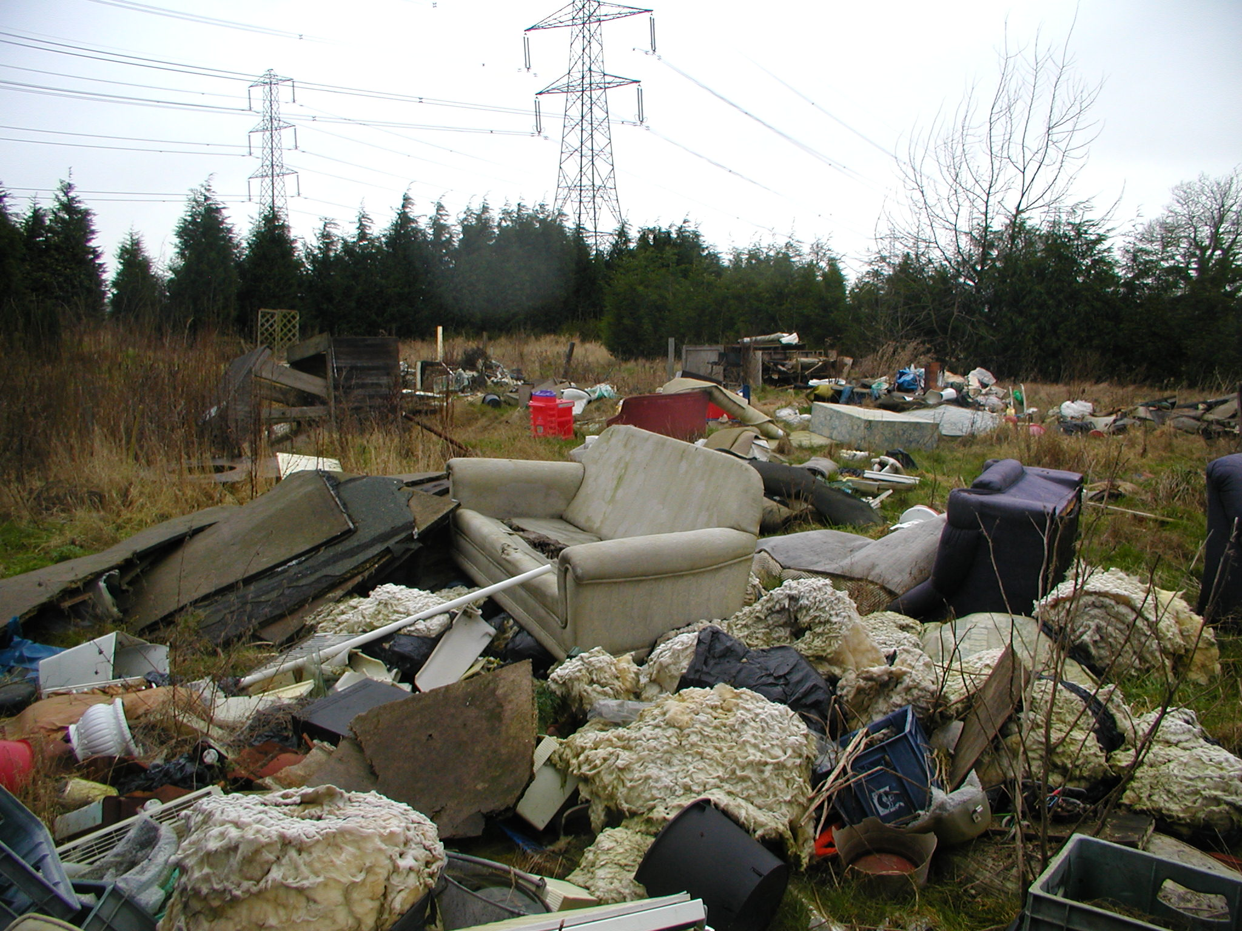
Waste Crime is not victimless
Flytipping: nearly 1 million incidents/yr
£70m cost to Local Authorities and rising
Total cost of waste crime = £0.6-1bn per annum? More?
Nearly 1000 new illegal sites added to EA database every year
Abandoned sites and fires, impact on communities

Slide 7
Tackling Waste Crime:
Tacking waste crime is still a priority issue for Government’s across the UK and the legitimate industry.
Resources are being provided to environmental regulators to crack down on waste criminals.
Waste Crime Action Plan: New enforcement measures introduced – more on the way.
Revised Duty of Care Code of practice.
Industry committed to playing its part : ‘right Waste, right Place’ campaign

Slide 8
Campaign Products
Dedicated website: Downloadable content, interactive, videos/animation, guidance, links to third parties – www.rightwasterightplace.com
Best Practice Guidance: ‘Simple guides’, case studies, waste ‘need to know’ cards, FAQs, leaflets, infographics and posters : easy to read, downloadable.
Market research: Gauge awareness of Duty of Care.
Press Office: drive interest in the campaign.
Active Engagement: Ambassador Programme.

Slide 10
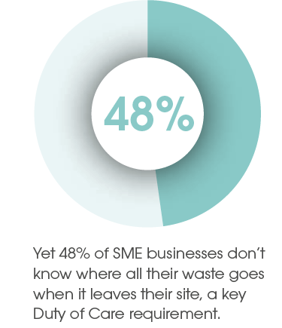
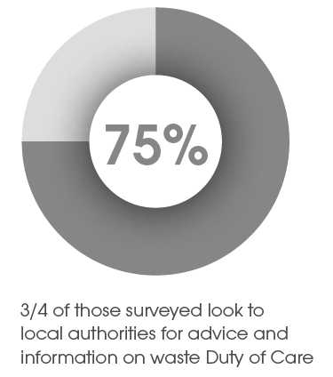
rWrP Campaign Survey
Survey of 1000 SME’s in construction, agriculture and retail sectors:

Slide 11
rWrP Campaign Survey
More than a third were unsure whether they completed Waste Transfer Notes (WTN)
Only half of construction businesses stored WTNs for the required two years
A quarter of construction businesses did not always separate their waste

Slide 12
Active Engagement
The campaign is managed by the ESA and sponsored and supported by CIWM, Environment Agency, ESAET and Natural Resources Wales.
Strong ‘buy in’ from a number of waste producing and waste managing business companies/sectors.
Ambassador Programme: Formalises engagement between the campaign and associated third parties and helps to promote the campaign through supply chains
Help available via rWrP, CIWM, etc!

Slide 13
Getting help
Download the free rWrP guides
Attend CIWM’s popular Duty of Care training course for more formal, tutored learning (ciwm.co.uk/training)
Get a construction-specific version of the Duty of Care course onsite for your teams
Join CIWM and ESA to access technical support and advice on complying with Duty of Care and other waste legislation
Sign up to the newsletters from ESA and CIWM to keep up to date with developments in waste management

Slide 14
Benefits of training
The team from Ballast Phoenix found that they left with a clear understanding of ‘duty of care’, how to remain compliant and an understanding of their responsibilities as producers. The training helped to provide full knowledge to staff new to the subject, and served as a refresher to those with existing knowledge.
Course attendees also observed that it helped them to realise their place in the chain of events that makes up their duty of care, and to better understand legislation, classifications of waste and the corresponding paperwork.

Slide 15
Ambassador Programme
Formalises engagement between the campaign and associated third parties.
Ambassadors commit to:
Providing evidence that the organisation embraces the principles of right Waste, right Place, and has an internal programme and policy on waste management.
Promoting best practice with regard to waste management.
Actively engage with RWRP to promote the campaign.

Slide 16
Ambassador Programme
…and expanding…
Notes:
Plus
Biffa
Keep Britain Tidy

Slide 17
Next Steps
Sector focus: Guidance, Case studies, seminars and training events
Expand the Ambassador Programme
Contact info@rightwasterightplace.com
Engagement with devolved governments to further expand the campaign

Slide 18
In Summary
Tacking waste crime is a priority
Awareness of Duty of Care across the whole waste chain is key to encourage behaviour change
Collaboration is key – Ambassador Programme
Focus on the construction sector
We welcome your support in the ‘Right Waste, Right Place’ campaign.

Slide 19
Thank you !
Website: www.rightwasterightplace.com
Email: info@rightwasterightplace.com
Follow: @RWRP2016
Like: info@rightwasterightplace.com
CIWM: www.ciwm.co.uk

