Slide 1
DRIM ToolKit – Revit Addin & Simulation Platform

Slide 2
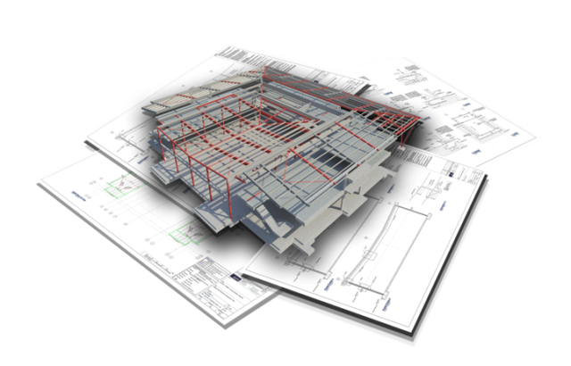
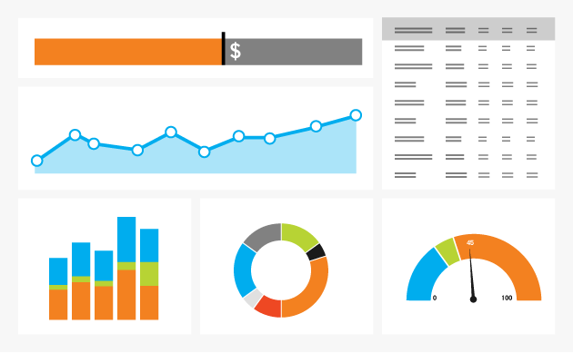
Deconstruction and Recovery Information Modelling
Demolition waste comprises significant proportion of valuable building materials that could be re-used for new constructions or refurbishment.
No such tool currently exists that can help in identification of valuable building materials for reuse & recycling.
The overall aim of this project is to develop an intelligence-based tool called Deconstruction and Recovery Information Modelling (DRIM) that will enable identification of reusable and recoverable building materials at end-of-life of a building.

Slide 3
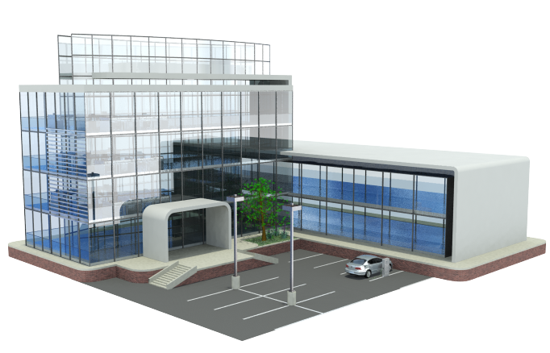
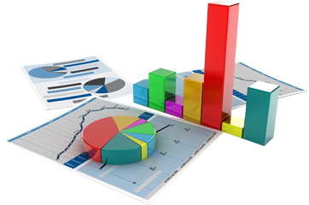
Key Functionalities of DRIM
DRIM Tool will enable:
production of deconstruction plan;
simulation of deconstruction process;
production of deconstruction protocols during demolition of the building to enable efficient recovery;
improved demolition waste collection schemes. The tool is aimed at both new and existing buildings sector.

Slide 4
Literature Review
The following are some of the findings from the literature review:
Design for Deconstruction is a design principle that influences the recovery potentials of building materials at the end-of-life.
Building Information Modelling (BIM) is required for proper coordination and management of building throughout its lifecycle
Big Data Analytics could be used to influence decision making throughout the lifecycle of a building.
Notes:
UWE to present

Slide 5
DRIM Deliverables

Slide 6
Revit Addin
A BIM-Based tool is integrated with Autodesk Revit to provide appropriate support to architects and design engineers during Design for Deconstruction (DfD), material tagging, and building end-of-life performance estimation;
The Add-in provides interfaces for the following:
Creation of new Deconstruction and Recovery Analytical (DRA) model
Design for Deconstruction support
DRA Reports Generation
Provide information about DRIM-Toolkit

Slide 7
Design for Deconstruction (DfD) Support
Information Modelling: Enables integration of appropriate material information and properties with design model. It also enables material recovery information tagging.
Visualisation: Provides visualisation support during DfD
Decision Support: Supports users during material specification for DfD
Exploratory Analytics: Visualises Material-Element mix
End-of-life Performance: Provides summary of end-of-life arisings in terms of materials that could be reused and recycled.
Deconstruction and Recovery Analytics (DRA)
Reporting Functionality

Slide 8
Design for Deconstruction Support
Arising Summary
Materials Table
Elements Table
Design Preview Panel
Properties Panel
Chart Panel
Components Navigation Table

Slide 9
(Walls, Struc. F., Struc. C.) ∩ (Plasterboard, Wood, Concrete)

Slide 10
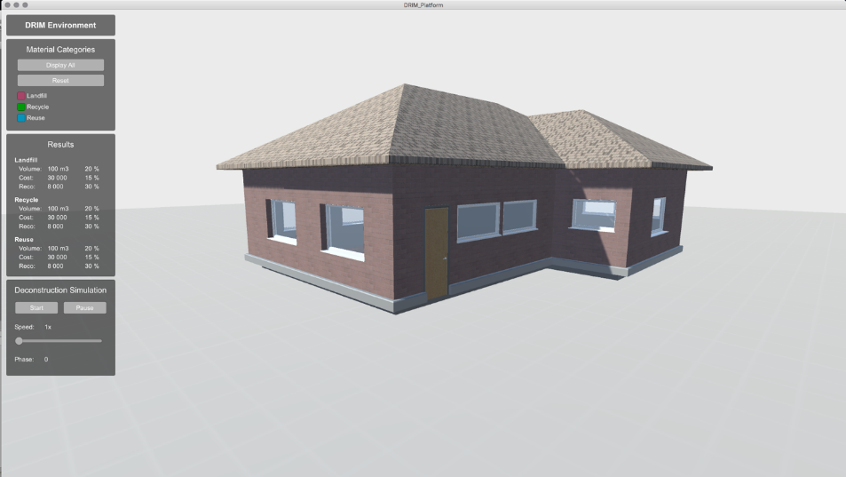
DRIM Simulation Platform
The Simulation Platform will provide visualisation to support building deconstruction process
The platform will also support whole-life performance analysis of building to determine the best time to refurbish, rebuild or relocate a building.

Slide 11
Identification of Component Categories

Slide 12
Separation of building components

Slide 13
We need your help?!
The DRIM project is looking for more data – if you have access to any buildings that we can come and audit please do get in touch!
If you wish to be on the newsletter circulation for DRIM please let me know!
Lara.Ayris@wasteplansolutions.co.uk
K.atkins@sustainabledirection.com

