Slide 1






Deconstruction and Recovery Information Modelling
Kris Atkins
Principal Consultant, Sustainable Direction Ltd

Slide 2


Big Data Analytics in Projects
7

Slide 3






Big Data Project Model Maturation Index
Measures the degree to which your organization has integrated big data and advanced analytics into your business model
Project
Metamorphosis
Data
Monetization
Project
Optimization
Project
Insights
Project
Monitoring
11
Notes:
Phase 1: Business Monitoring: Vast majority of organizations today are at the Business Monitoring stage, where they deploys business intelligence to monitor current business performance
Phase 2: Business Insights: Organizations leverages predictive analytics to uncover actionable insights that can be integrated into existing reports and dashboards
Phase 3: Business Optimization: Organizations embed predictive analytics into existing business processes to optimize select business operations
Phase 4: Data Monetization: Organizations creates new revenue opportunities by 1) reselling data and analytics, 2) creating “intelligent” products, or 3) over-hauling the customer engagement experience:
Phase 5: Business Metamorphosis: Organizations leverages customers’ usage patterns, product performance behaviors, and market trends to create entirely new business models
Key observation: as organizations move along the maturity curve, they will…
Build out their data assets and analytics intellectual property (IP)
Build out ability to make decisions more quickly, more frequently and with a higher degree of confidence

Slide 4


Evolution Of The Analytic Process
Project Intelligence versus Project Analytics
Data Science (Advanced Analytics) – Project Analytics
Typical Techniques and Data Types | Optimization, Predictive modeling, forecasting statistical analysis Structured/unstructured data, any types of sources, very large data sets
Common Questions | What if…? What’s the optimal scenario for our business? What will happen next? What if these trends continue? Why is this happening?
High
Data
Science
BUSINESS
VALUE
Business Intelligence – Project Intelligence
Typical Techniques and Data Types | Standard and ad hoc reporting, dashboards, alerts, queries, details on demand Structured data, traditional sources, manageable data sets
Common Questions | What happened last quarter? How many did we sell? Where is the problem? In which situations?
Business
Intelligence
Low
Past
TIME
Future
12
Notes:
Many organizations are trying to define what big data means to them. At EMC we believe there is an evolution underway in the way analytic processes are defined. The paradigm is shifting from business intelligence to advanced analytics powered by data science. In order to gain meaning from Big Data, you need “Data Science”.
So what are the main differences between Business Intelligence and Data Science. BI reports on historical performance retrospective reporting and on-going business monitoring BI is good at answering the questions What happened last quarter? How many did we sell?
Data science is about predicting the future and understanding why things happen The questions What is the optimal solution? What will happen next? These questions come to mind when we discuss Data Science. Data science also provides a new approach to uncovering and acting on the insights buried across the wealth of available data sources

Slide 5


DRIM - Deconstruction and Recovery Information Modelling
5

Slide 6
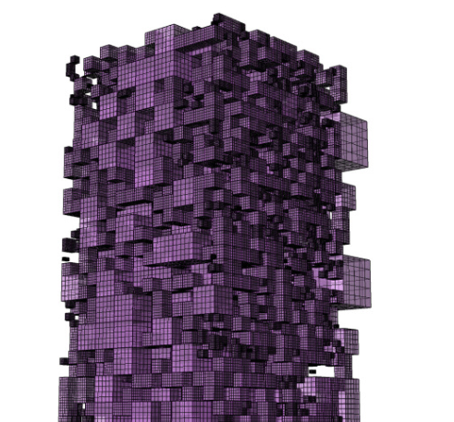
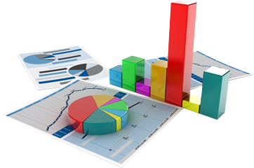




DRIM - Deconstruction and Recovery Information Modelling
Aim
To develop an intelligence-based BIM tool that will enable identification of reusable and recoverable materials at end-of-life of Projects.
Cost: £800,000
Funding body: EPSRC
Timescale: 2016 - 2019
Partners:
6

Slide 7
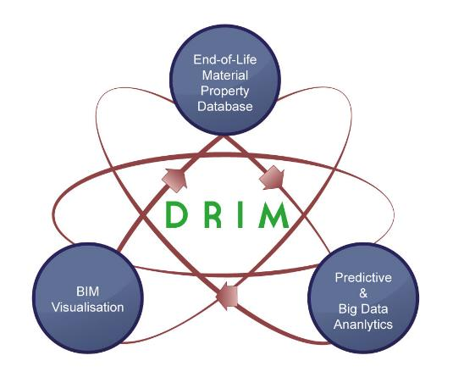
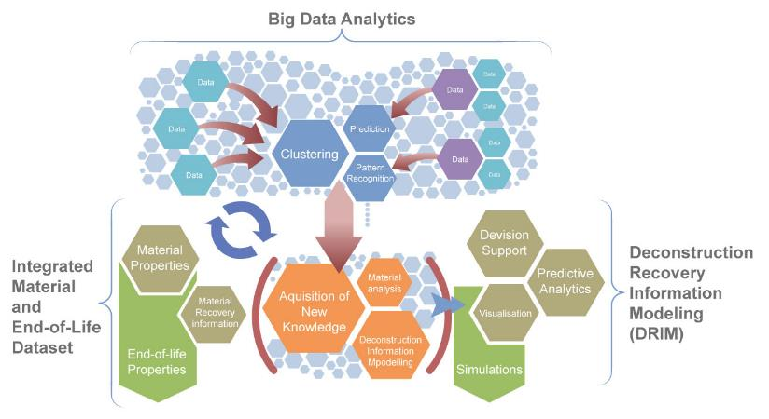
Conceptual frameworks
Developing a real life product for better recovery and re-use of “used” building materials.

Slide 8

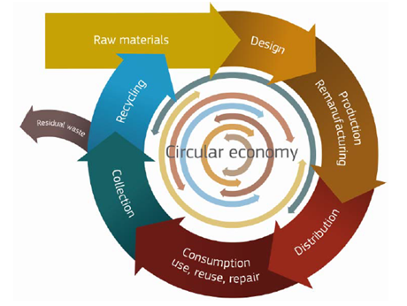
  DRIM is all about improved circular economy in the construction industry.
  DRIM will be a design-based tool for incorporating material intelligence for better material recovery and re-use
  At the end, this will help to divert construction and demolition waste from landfills at the end-of-life of buildings.

Slide 9

How DRIM will be achieved

Slide 10
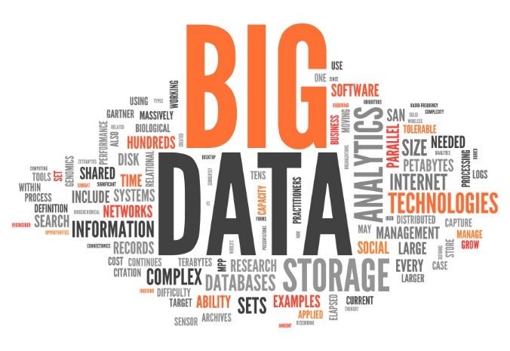
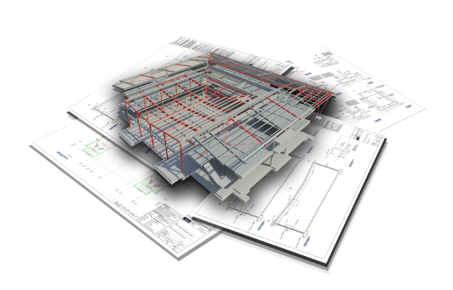
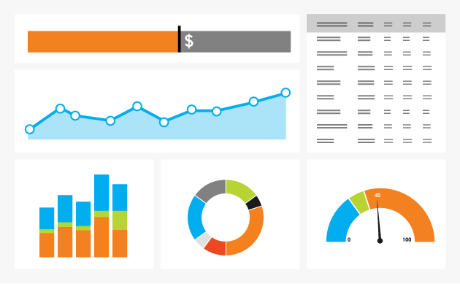
How DRIM will be achieved
  DRIM will use innovative technologies that include ontologies and semantic technologies to store end-of-life properties of materials
  DRIM will use Big data analytics to predict end-of-life properties and value of building materials.
  DRIM will incorporate state-of-the-art visualisation methodologies to simulate building deconstruction process
  DRIM will be interoperable with existing BIM platforms

Slide 11
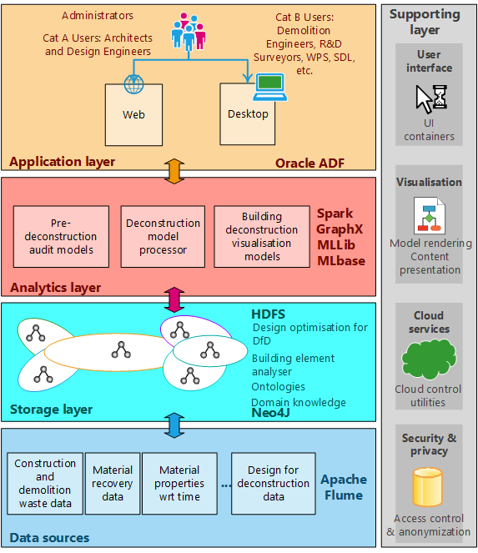
Big data analytics conceptual framework

Slide 12
Components of DRIM
The DRIM tool is made up the following major components:
  Building Element Analyser (BEA)
    Input: BIM design
    Output: Materials take-off from building design
  Design Optimisation for Design for Deconstruction (DfD)
    Input: Materials take-off
    Output: Optimised DfD based on global best practices
  Pre-Deconstruction Audit Processor (PDAP)
    Input: Materials take-off
    Output: Pre-Deconstruction audit data
  Deconstruction Plan Generator (DPG)
    Input: Materials take-off
    Output: Deconstruction protocol, Deconstruction process visualisation

Slide 13
A SQL/NoSQL semantic storage for data
Contractors
Predictive Analytics
Data Sources
SQL/NoSQL Data Storage
Consultants
Data Sources
Clients
Data Sources
- Hadoop
- MapReduce
- HDFS, etc.
- Demolition Data
- Building Design
- Material Take-off.

Slide 14

Thank You

